Slide 1
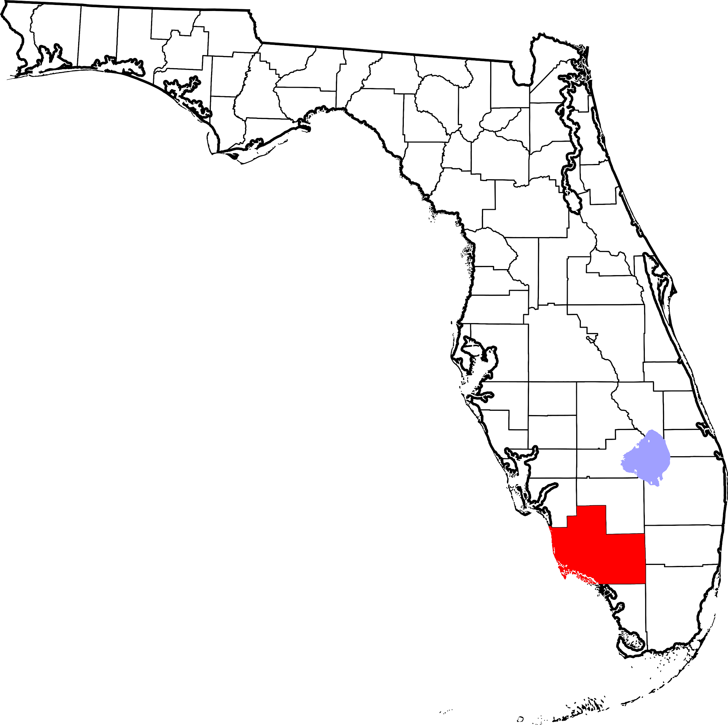
BALLOT
HAND COUNTING PROCESS
A Florida Handbook
for
Collier County
November 29, 2023
Developed by the Collier County
Republican Executive Committee
Election Integrity Committee

